Slide 1
Independent Project
Katelyn Supinski, Megan Neuberg,
Katherine Kosovich, & Amy Cimperman

Slide 2
Outreach
Tuesday, April 30, 2013
North Star Edison Charter School
Two First Grade Classes

Slide 3
Activity Plan GloFish Color Inheritance
Purpose of Lesson: This lesson’s purpose is to instruct students on the inheritance patterns of the colors of GloFish and to ensure that given a GloFish cross, the students will be able to correctly predict reasonable colors of offspring.

Slide 4
Discussion
Mixing colors
Punnett Square
Each fish has two color genes they can give (one comes from the mother fish and one comes from the father fish).

Slide 5
Conformation of Knowledge

Slide 6
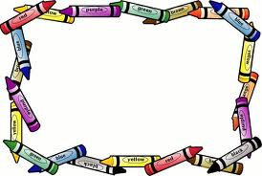
Time to Color!!

Slide 7
Activity
Six tanks: 3 parents, 3 offspring
Write down observations
Match tanks

Slide 8
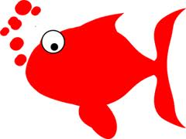
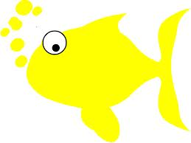
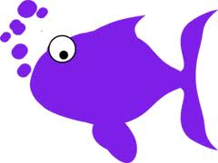
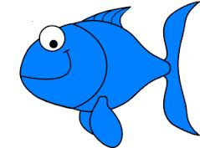
A
C
B

Slide 9
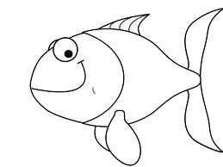

Slide 10
A =
B =
C =

Slide 11
Did it all go as planned?
x
Absolutely NOT

Slide 12
What really happened...
Split up into four groups
Gave quick background
Front of worksheet
Looked at the fish

Slide 13
How did the students react?

Slide 14
But nonetheless….

Slide 15
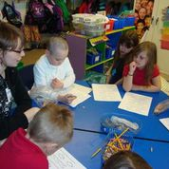
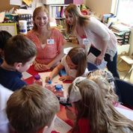
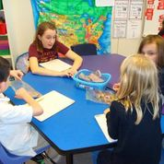
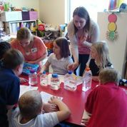
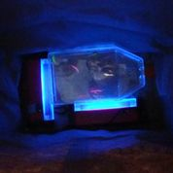
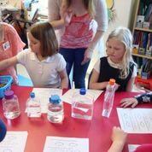
They enjoyed it!

Slide 16
What we would change…
Simplify!!
Less students in one room

